Slide 1


Old Oak Neighbourhood Forum and Grand Union Alliance
Thursday February 5th 2026
On Zoom

Slide 2
Agenda for this evening
Latest HS2 works including tunnelling to Euston
Agenda items for Residents Panel meeting Feb 12th
Update on OPDC Masterplan Framework and CPO Order
Developments in the pipeline
Frogmore data centre
2 Scrubs Lane
North Kensington Gate (North site)
Draft slides on OONF Neighbourhood Plan for Feb 12th

Slide 3
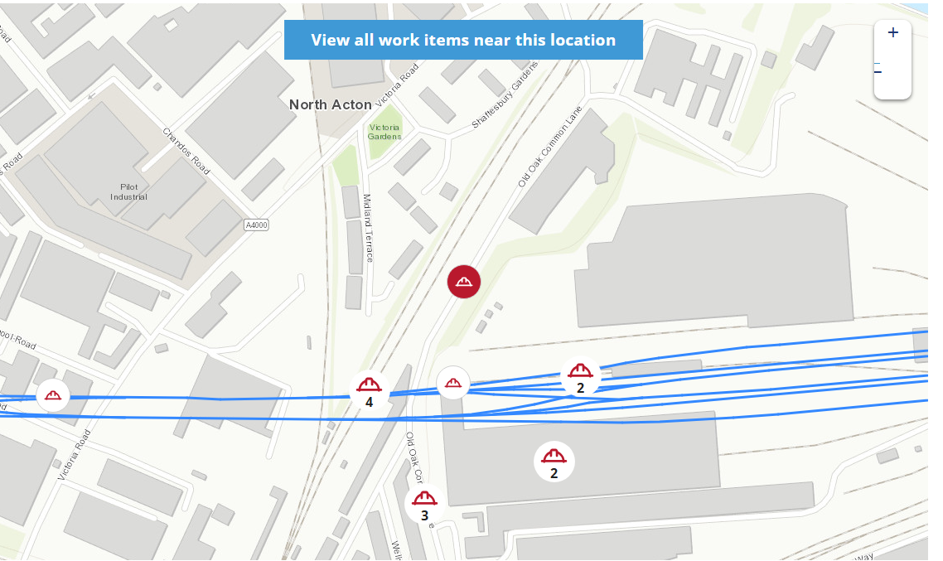
Latest map of HS2 works

Slide 4
Agenda items for Residents Panel 12th Feb
These are the items which we have asked to be on the agenda:
1. Timeline on what happens next on OPDC Delivery Team securing a ‘development partner’ to work up schemes in the Masterplan.
2. An explanation of roles and relationships within the GLA ‘family’. (This item seeks info on how OPDC arrange their loans and who vets them - GLA Housing and Land team and GLAP (property arm of GLA)?
3. An update on the CPO Order and a request to see all objections (including use of Kildun Court and timeline for ‘east west bridge’).
4. The legal status of the Masterplan Framework document?
5. OONF proposals for a Draft Neighbourhood Plan and an extended boundary.

Slide 5
OPDC Masterplan Framework
200 page document ‘endorsed’ OPDC Board 20th November.
Followed from exhibitions and PlaceLab sessions.
But not consulted on as a complete document.
OONF has written 3 times pointing out this is not a ‘development plan document’ and has little ‘material weight’.
OPDC argue that ‘weight’ will be judged at stage of individual applications (and are not proposing an app for the Masterplan).
Also saying all applications should ‘take account’ of its content. OPDC. How can this be imposed as a requirement?
A fundamental disagreement – as yet unresolved.

Slide 6
OPDC CPO Order
Submitted to Sec of State last September for final approval.
No news on appointment of Planning Inspector, the content of objections submitted, or date for a Planning Inquiry.
OONF objection questioned use of Masterplan to support the CPO and misinformation on dates for HS2 project completion.
OPDC has previously said they will not discuss these matters at the Residents Panel. No response to request for copies of objections (which we need for neighbourhood plan purposes).
Properties in Old Oak Lane, WHR and Midland Terrace/Shaftesbury Gardens affected plus Fishermans Arms and Collins Garage at Goodhall Street.

Slide 7
Developments in the pipeline
Frogmore data centre – OONF has yet to submit an objection. Petitions submitted from Wesley Estate Residents.
2 Scrubs Lane – detailed objection to Jeeran application submitted by StQW Neighbourhood Forum. 40 other objections.
North Kensington Gate (North) at 93-97A Scrubs Lane – OPDC Planning Committee had granted consent at its 22nd Jan meeting.

Slide 8
Draft slides for OPDC Residents Panel
(The Zoom session reviewed a set of slides proposed to be used at the February 12th meeting of the Panel and made some comments and suggestions.
This slideset was subsequently amended and this version is available as part of a post on the OONF website).

